Slide 1
20180817 랩미팅
김현지

Slide 2
Using General Adversarial Networks for Marketing:
A Case Study of Airbnb (2018)

Slide 3
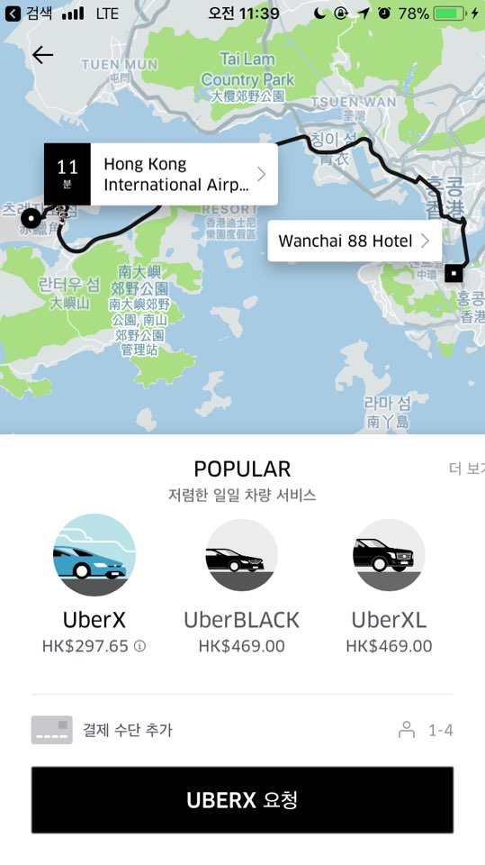


Slide 4



Slide 5
Data:
Acquired from Airdna
Airbnb listings from Manhattan, NY
From Jan 1,2016 to Jan 1,2017
Roughly 40,000 listings
For each listing,
# of bathrooms
# of bedrooms
Zip code
Host description
Price
Occupancy rate
RNN LSTM
GAN

